Slide 1
IMAGE DENOISING - NON LOCAL MEANS
Image processing course project
Gourab gHosh roy
Raabid hussain
Yogesh langhe
SANJAY BASAK
Arjun bALAkrishnan

Slide 2
Organization
Introduction
Local Means Filters
Non-Local Mean Filter
Algorithm
OBNLM filter
Python and MATLAB Implementations
Quantitative Analysis
Ultra-Sound Imaging
Qualitative Analysis
SD-OCT Retinopathy
Conclusion

Slide 3
Introduction
Noise by Imaging Systems
Noise independent of neighborhood
Noise Models
De-noising schemes

Slide 4
LOCAL MEANS METHODS
Methods considering neighborhood around a target pixel for denoising
Gaussian filtering
Anisotropic filtering
Total Variation filtering
Frequency domain filters
Due to the regularity assumptions on the original image of these methods, details and fine structures are smoothed out because they behave in all functional aspects as noise.

Slide 5
WHAT IS NLM
All pixels in an image is considered for denoising one pixel
The local smoothing methods and the frequency domain filters aim at a noise reduction and at a reconstruction of the main geometrical configurations but not at the preservation of the fine structure, details and texture.
Takes advantage of high degree of redundancy in natural images
Regularity assumption:
For any pixel i another pixel j in the same image can be defined such that the patch around i is similar as patch around j
The fact that such a self-similarity exists is a regularity assumption, actually more general and more accurate than all regularity assumptions used by local means techniques. It also generalizes a periodicity assumption of the image.

Slide 6

The Algorithm - Pixelwise
Notations used:
dim – size of the image
$N_{i}$ - square neighbourhood of size${ (2d +1)}^{dim}, d∈N$
u$\left(N_{i}\right)$ - the grey level vector containing the values at each pixel in $N_{i}$
$Z_{i}$ - Normalizing constant ensuring that $\sum_{x_{i}∈dim}{w\left(i ,j\right)=1}$
$w\left(i ,j\right)=\frac{1}{Z_{i}}\exp{− \frac{{\left\|u\left(N_{i}\right)−u(N_{j})\right\|}_{2,a}^{2}}{h^{2}}}$ - Weight assigned to a pixel i
$NL\left(u\right)\left(i\right)= \sum_{j∈dim}{w\left(i ,j\right)u(}j)$

Slide 7

The Algorithm - Blockwise
Notations used:
$B_{i}$ - square block centred at pixel i, size${ (2a +1)}^{dim}, a∈N$
u$\left(B_{i}\right)$ - the grey level vector containing the values at each pixel in $B_{i}$
$Z_{ik}$ - Normalizing constant ensuring that $\sum_{Bi ∈ dim}{w\left(B_{ik},B_{j}\right)=1}$
$w\left(B_{ik},B_{j}\right)=\frac{1}{Z_{ik}}\exp{− \frac{{\left\|u\left(B_{ik}\right)−u(B_{j})\right\|}_{2}^{2}}{h^{2}}}$ - Weight assigned to a pixel i
$NL\left(u\right)\left(B_{ik}\right)= \sum_{B_{i}∈dim}{w\left(B_{ik},B_{j}\right)u(}B_{j})$

Slide 8

The Algorithm - OBNLM
Bayesian Formulation
Empirical estimation
$𝕍\left(B_{ik}\right)= \frac{\frac{1}{|Δ_{ik}|}\sum_{j=1}^{|Δ_{ik}|}{u\left(B_{j}\right) p(u\left(B_{ik}\right)|u\left(B_{j}\right)})}{\frac{1}{|Δ_{ik}|}\sum_{j=1}^{|Δ_{ik}|}{p(u\left(B_{ik}\right)|u\left(B_{j}\right)})}$
Adapting NLM method for speckle noise
$u\left(x\right)=v\left(x\right)+ v^{γ}\left(x\right)∗η(x)$ - Model for speckle noise
Euclidian distance is updated with Pearson distance
$dp\left(u(B_{i}),u(B_{j})\right)=\sum_{p=1}^{P}{\frac{{(u^{p}\left(B_{i}\right)−u^{p}(B_{j}))}^{2}}{u^{p2γ}(B_{j})}}$

Slide 9
Implementation of Algorithms
MATLAB Code available
Python Programming

Slide 10
Analysis
Types of Noises
Uniform
Gaussian
Rician noise
Salt and Pepper noise
Filter Comparison
Mean filter
Median filter
Lee filter
Wavelet filter

Slide 11
Quantitative Analysis (LENA)
Noise | PSNR of Noisy Image | PSNR - Denoised with Mean Filter | PSNR - Denoised with Median Filter | PSNR- Denoised with Lee Filter | PSNR-Denoised with Wavelet Filter | PSNR-Denoised with NLM/OBNNLM
Gaussian | 20.0860 | 27.6252 | 26.7417 | 26.5340 | 27.5931 | 29.2267
Rician | 23.2042 | 29.3079 | 28.9104 | 27.8725 | 28.6831 | 32.1794
Uniform | 20.0067 | 27.5304 | 25.0774 | 26.7080 | 27.4885 | 28.8179
Salt and Pepper | 15.4280 | 23.6948 | 33.0020 | 23.2594 | 19.3687 | 25.0284
Speckle | 21.7589 | 28.7335 | 27.7250 | 27.4711 | 28.3689 | 30.1096

Slide 12
Quantitative Analysis (CAMERAMAN)
Noise | PSNR of Noisy Image | PSNR - Denoised with Mean Filter | PSNR - Denoised with Median Filter | PSNR- Denoised with Lee Filter | PSNR-Denoised with Wavelet Filter | PSNR-Denoised with NLM/OBNNLM
Gaussian | 20.3798 | 27.7208 | 27.0006 | 27.4004 | 27.3274 | 29.5234
Rician | 23.4063 | 29.5739 | 29.2789 | 28.8253 | 28.7383 | 32.6850
Uniform | 20.3500 | 27.6589 | 25.4028 | 27.0649 | 27.2177 | 29.1913
Salt and Pepper | 15.1170 | 23.3207 | 33.5316 | 23.1404 | 17.2397 | 23.2909
Speckle | 21.5722 | 28.8451 | 27.8285 | 28.0837 | 28.4931 | 30.9460

Slide 13
Quantitative Analysis (BABOON)
Noise | PSNR of Noisy Image | PSNR - Denoised with Mean Filter | PSNR - Denoised with Median Filter | PSNR- Denoised with Lee Filter | PSNR-Denoised with Wavelet Filter | PSNR-Denoised with NLM/OBNNLM
Gaussian | 20.0285 | 22.1168 | 21.8368 | 22.0667 | 20.7899 | 24.6274
Rician | 23.1991 | 22.5565 | 22.5426 | 22.4631 | 21.1191 | 25.9162
Uniform | 20.0023 | 22.1162 | 21.4571 | 22.0665 | 20.7793 | 24.6104
Salt and Pepper | 15.5606 | 20.6861 | 22.8245 | 20.6496 | 20.2261 | 21.4522
Speckle | 21.2450 | 22.3899 | 22.1120 | 22.3293 | 20.9721 | 25.0315

Slide 14
Optimal Internal Parameters
Filter Window Size
Search Window
Degree of filtering/smoothing

Slide 15
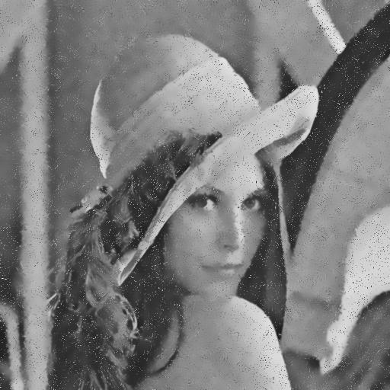

Degree of filtering

Slide 16
Ultra Sound(US) Images
Phenomena
Multiplicative Noise
Speckle noise
Difficult to model
Log-compressed images

Slide 17
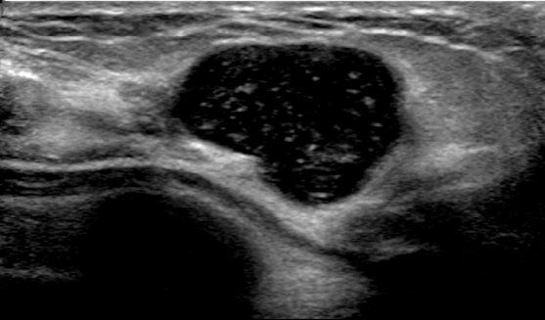
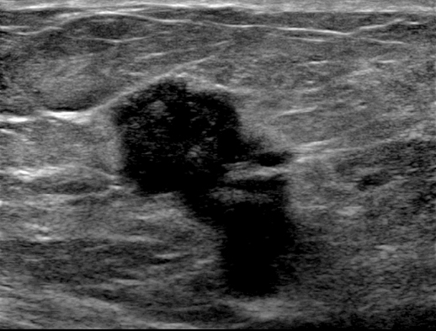
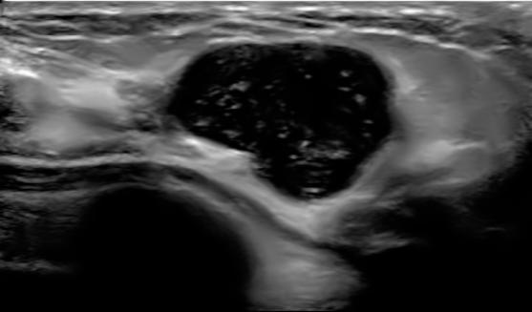

Speckle Removal on US images

Slide 18
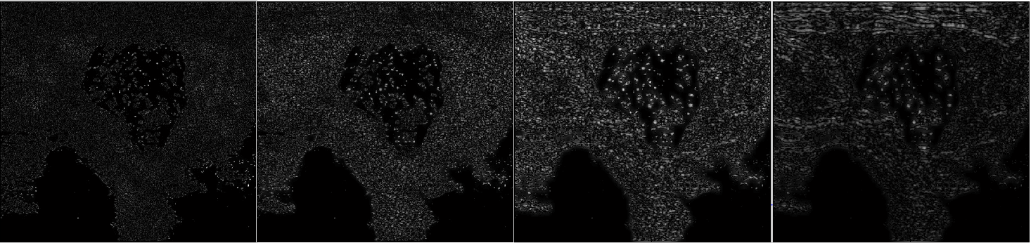
Method Noise

Slide 19
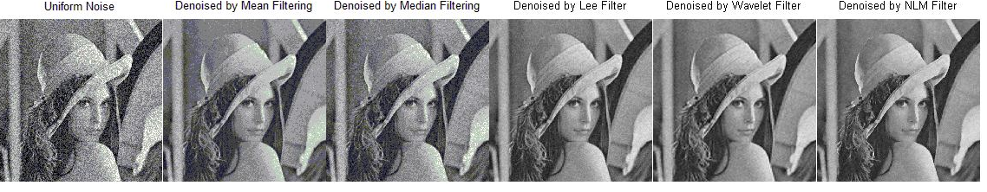
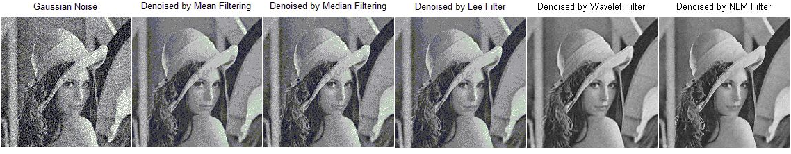
Qualitative Analysis

Slide 20
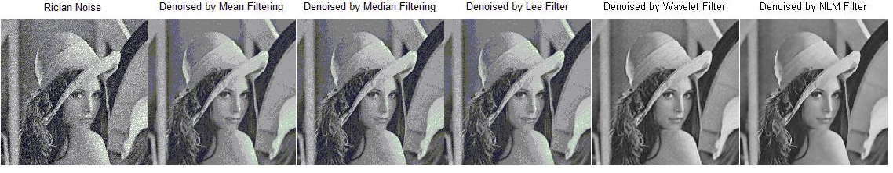
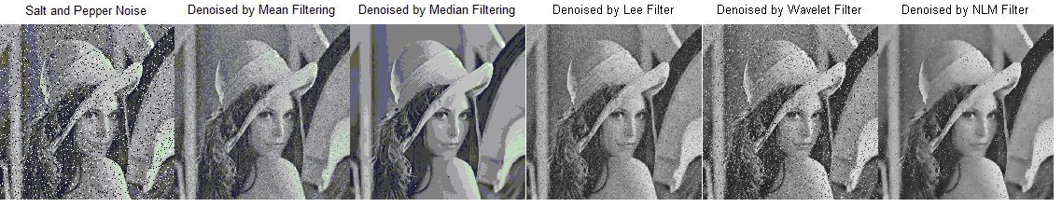
Qualitative Analysis

Slide 21
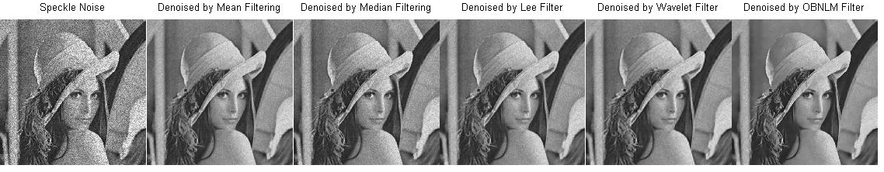
Qualitative Analysis

Slide 22
RETINOPATHY
The retina is the thin membrane that lines the back of the eye and contains light-sensitive cells (photoreceptors). Light enters the eye and is focused onto the retina.
Retinopathy is persistent or acute damage to the retina of the eye.

Slide 23
SD-OCT
Spectral Domain-Optical Coherence Tomography (OCT) is to test the retinopathy.
We have some SD-OCT images with noise, so we denoised it using NLM filter.
Then, we segmented the denoised images to find the different layers.

Slide 24
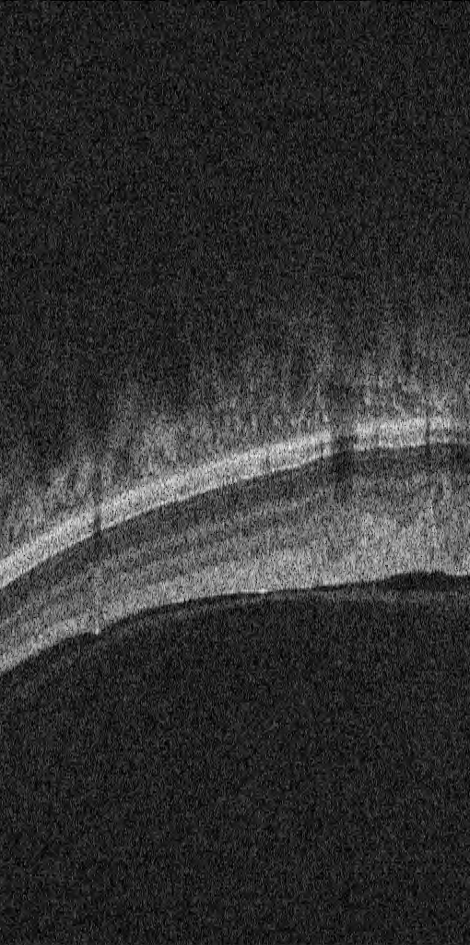

Result: Denoise using NLM
Noise image
Denoised image

Slide 25
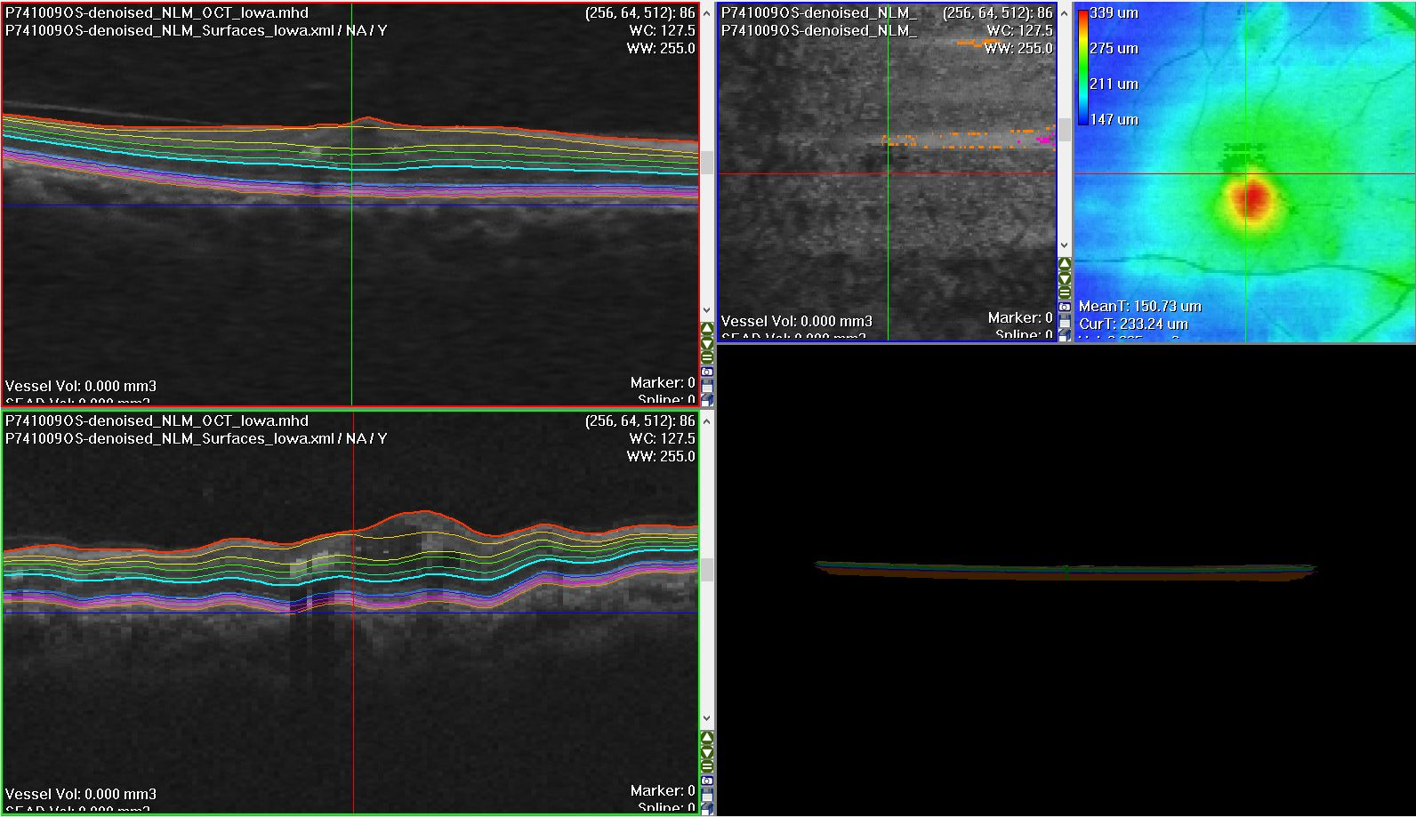
Results

Slide 26
Concluding Remarks
No geometrical structures
Restoration of Natural Images
Best Quantitative and Qualitative results

Slide 27
References
A. Buades, B. Coll, and J. M. Morel, \A non-local algorithm for image denoising,“ Multiscale Model. Simul., vol. 4, no. 2, pp. 490{530, 2005.
P. Coupe, P. Hellier, C. Kervrann and C.Barillot, \Nonlocal Means-Based Speckle Filtering for Ultrasound Images," IEEE Trans. Image Proc., vol. 18, no. 3, Oct. 2009
http://fr.mathworks.com/matlabcentral/fileexchange/13176-non-local-means-filter
https://sites.google.com/site/pierrickcoupe/softwares/denoising-for-medical-imaging/speckle-reduction

Slide 28
Thank You!

